Slide 1
Graded Quiz Question #1
Which food has the most Calories per gram (grams of Carb/Protein/Fat in parentheses)?
Maple Syrup (67/0/0)
Atlantic Cod (0/62/3)
Hazelnuts (17/15/60)
They are all the same Calories/g

Slide 2
Graded Quiz Question #2
Which component of energy expenditure is affected by the composition of your most recent meal
Resting energy expenditure
Diet-induced thermogenesis
Non-exercise active thermogenesis
Exercise active thermogenesis

Slide 3
Graded Quiz Question #3
Which hormone is secreted from your gut when it is not full
Gastrin
CCK
Ghrelin
GLP1

Slide 4
Essentiality, Energy and Efficiency
Essentiality
What can we make? what must we ingest?
Energy from macronutrients
Efficiency of digestion and metabolism

Slide 5
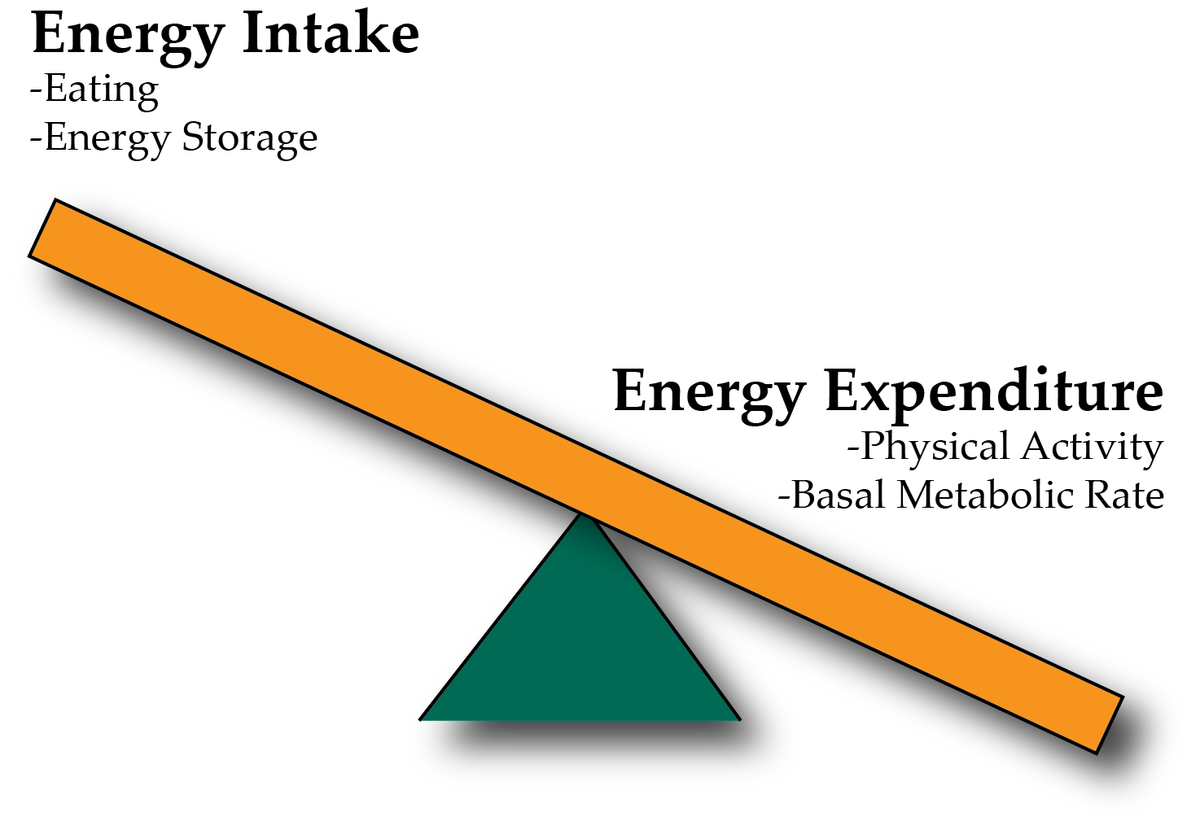
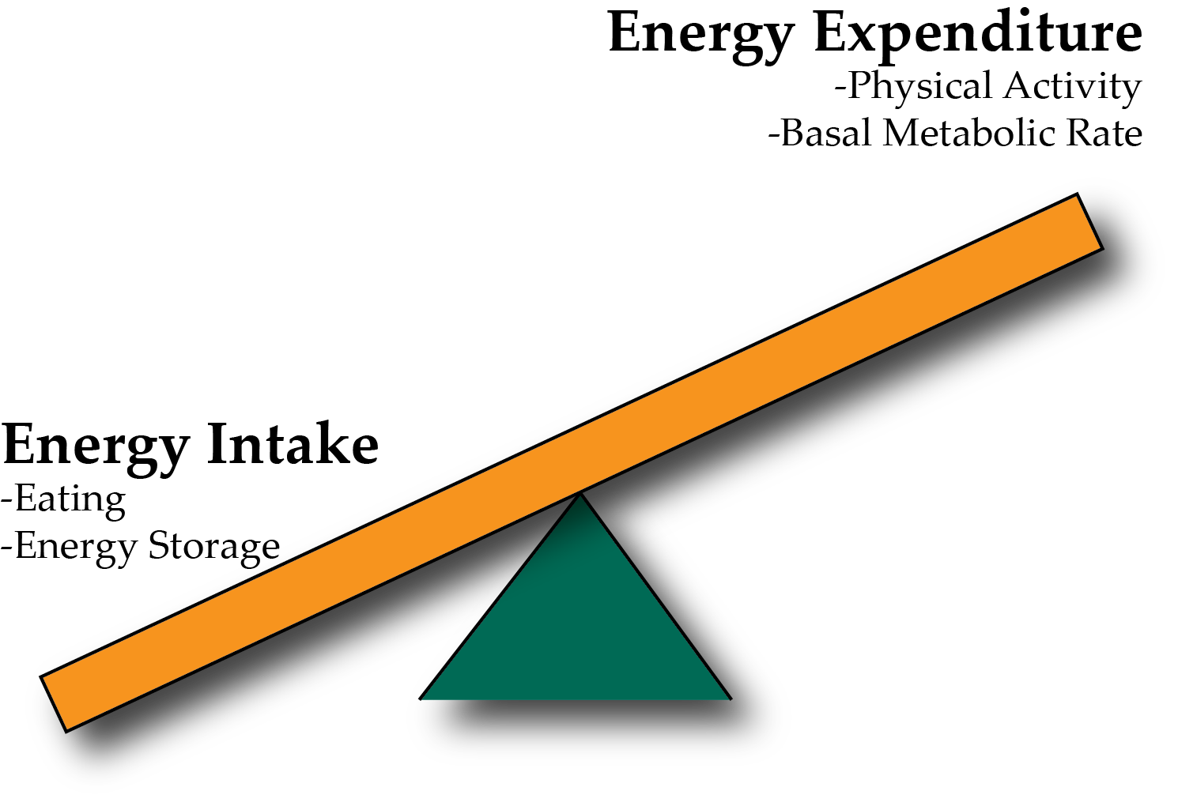
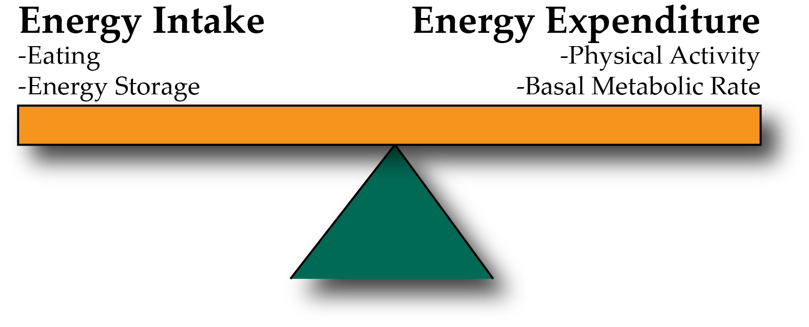
Energy Balance and Obesity
Positive Energy Balance – Weight Gain
Negative Energy Balance – Weight Loss
Notes:
Be here at 9:20

Slide 6
Concept Map

Slide 7
Terms for your concept map
Energy Intake
Energy Expenditure
Sensing Fullness
Appetite
Energy Excretion
Atwater Factor
Basal Metabolic Rate
Thermic Effect of Food
Exercise Activity Thermogenesis
Ghrelin
Energy Balance
Weight Gain
Weight Loss
FFQ
Diet Recalls
Fecal Energy Content
Gut Nutrient Sensing
Calories in Food
Energy Ingested
Drive to eat

Slide 8
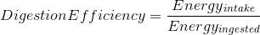
Assessing Energy Intake
Several methods of assessing energy intake
Observational
Diet Recall Surveys
Food Frequency Questionnaires
More about diet recalls in an optional assignment
Notes:
Start at 1:15

Slide 9
Why do we start and stop eating?
Why do we eat
Why do we stop eating
Drive for food
Low blood glucose
Stress
Stomach is full and full of nutrients
Changes in gut-derived hormones
Vagal signaling
Rise in insulin and glucose
~20 minute lag between eating and feeling full

Slide 10
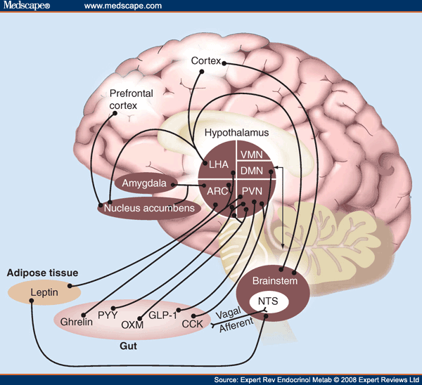
The Central Role of The Hypothalamus

Slide 11
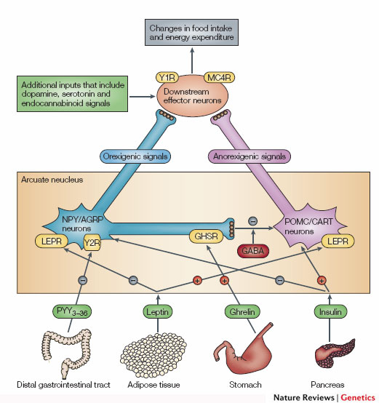
The Central Controller of Appetit is a Circuit in the Hypothalamus (NPY/POMC neurons)
Promotes
Eating
Suppresses
Appetite
Notes:
Two populations of neurons in the arcuate nucleus.

Slide 12
Stress
Cortisol activates hypothalamic POMC neurons
These neurons promote feeding
Activation drives feeding behavior

Slide 13
Timed feeding cues
Cortisol awakening response
Sharp rise in cortisol shortly before waking up
May differ between chronotypes
How do you think this would affect feeding behaviors?
Kudielka BM, Federenko IS, Hellhammer DH, Wüst S. Morningness and eveningness: The free cortisol rise after awakening in “early birds” and “night owls.” Biol Psychol. 2006; 72: 141–6. doi: 10.1016/j.biopsycho.2005.08.003.

Slide 14
Why do we stop eating?
The role of our gastrointestinal system
Notes:
~20 minute lag between eating and feeling full

Slide 15
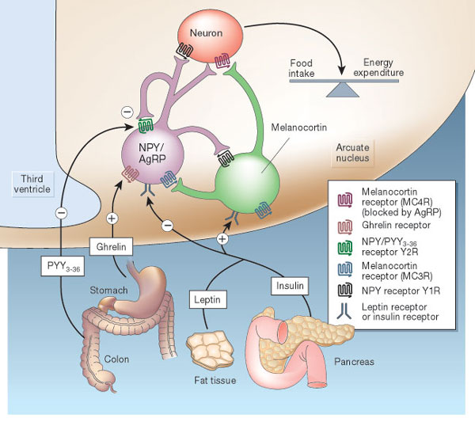
Hormonal Control of Appetite
-
GLP1
Notes:
Think about it this way… AgRP neurons like to be on, and when they are on they increase appetite.

Slide 16
Vagal Nerve Signaling
Notes:
Enteric nervous system
Second brain
500 million neurons

Slide 17
Metabolic Signals
Glucose
GLP1 in the small intestine
Sensed directly by hindbrain and hypothalamus
Insulin
Sensed at hypothalamus
Proteins and Lipids
In the gut (CCK)
In the liver (FGF21)
May be direct sensing at hypothalamus
Leptin
Related to adipose tissue size

Slide 18
Summary of gut signals
Signal | Effect of food | Effect
Vagal stimulation | Stimulation | Inhibitory
GLP-1 | Secreted by small intestine | Inhibitory
PYY (Peptide YY) | Secreted by small intestine | Inhibitory
CCK | Secreted by small intestine | Inhibitory
Ghrelin | Stomach secretion stops with food | Activating

Slide 19
Mindful Eating Thought Experiment
Normal signals regulate drive to eat, and feelings of fullness
Dieting may change our normal responses
Mindful eating is proposed to restore normal sensing
Pretend you have an study of people who are or are note trained in mindful eating.
At your table, pick a physiological factor that you hypothesize would be different between these groups. How would it be different?
Notes:
Be here at 1:45-1:55

Slide 20
Other functions of GI hormones

Slide 21
Endocrine Regulation of GI Function

Slide 22
Summary of Enteroendocrine Hormones
Hormone | Released from | Roles
Gastrin | Stomach (amino acids, stomach stretch, PNS) | Release acid into stomach, increase motility
Secretin | Small Intestine (acid) | Release bicarbonate into small intestine
CCK (Cholecystokinin) | Small Intestine (fatty acids and amino acids, PNS) | Bile Secretion, Pancreatic Enzyme Secretion, reduces motility
Motilin | Small Intestine | Increased motility
Parasympathetic Nervous System | Brain | Rest and digest, release of CCK, Gastrin
Sympathetic Nervous System | Brain | Fight or flight, pyloric sphincter

Slide 23
Interested in, or need a refresher in anatomy?

Slide 24
Energy Expenditure

Slide 25
Parts of the Metabolic Rate
Energy Expenditure Component | Increased by
Exercise Activity Thermogenesis (NEAT/EAT) | Exercise and movement
Thermic Effect of Food (TEF) | Protein in Meal, Insulin Sensitivity, Meal Size
Basal Metabolic Rate | Young Age, Sex (M), Lean Mass, Set Point
Maclean PS, Bergouignan A, Cornier M-A, Jackman MR. Biology’s response to dieting: the impetus for weight regain. Am. J. Physiol. Regul. Integr. Comp. Physiol. 2011;301(3):R581–R600. http://dx.doi.org/10.1152/ajpregu.00755.2010
Notes:
Impact of weight loss on the components of total energy expenditure (TEE). Energy-restricted weight loss impacts every component of energy expenditure. The absolute levels of resting energy expenditure (REE) decline from a loss of metabolic mass and enhanced metabolic efficiency. Nonresting energy expenditure (NREE) declines, unless the level of physical activity and its associated exercise activity thermogenesis (EAT) are substantially increased. This increase must overcome the decline in the TEF that results from lower energy consumption and a decline in nonexercise activity thermogenesis (NEAT) related to loss in overall mass. Increased energetic efficiency of EAT, NEAT, and potentially TEF contribute to the overall decline in NREE.

Slide 26
Energy Expenditure and Metabolism

Slide 27
Major Determinants of Resting Energy Expenditure
Amount of metabolically active tissue (fat-free mass)
Strong relationship between REE and Fat-Free Mass
Modified by
Age (declines with age)
Sex (~11% higher in males)
Genetics (V_{g} ~ 11%)
Illner K, Brinkmann G, Heller M, Bosy-Westphal A, Muller MJ. Metabolically active components of fat free mass and resting energy expenditure in nonobese adults. Am J Physiol Endocrinol Metab. 2000; 278: E308-15.
Notes:
The major factors that contribute to the BMR are age (declines with age), sex (approximately 11 % higher in males) and body mass, particularly fat-free (or lean) mass. Up to 85 % of the variance in BMR can be explained by these factors,

Slide 28
Using Energy Balance Concepts
If one knows the energy intake, and the energy expenditure you can calculate energy surplus (or deficit)
This surplus (or deficit) changes the energy stored in our body (primarily in our fat depots)

Slide 29
Deriving 500 Calorie “Rule”
Calculate the number of calories stored in one pound (454g) of fat tissue based on its Atwater factor and the percent of lipid in fat (87% lipid).
What daily caloric deficit would be needed, presuming Energy Expenditure is constant. Calculate this for a timeframe of:
One week
One month
One day
Notes:
1 -> 454 g x 0.87 x 9 kca/g = 3500 calories
2 -> 500 cal/day (week), 118cal/day (month) or 3500 cal/day (day)

Slide 30
This does not work, why?

Slide 31
Over/underfeeding and metabolic rates
Leibel R, Osenbaum MIR, Leibel RL, Rosenbaum M, Hirsch J. Changes in energy expenditure resulting from altered body weight. N. Engl. J. Med. 1995;332(10):621–8. http://dx.doi.org/10.1056/NEJM199503093321001

Slide 32
The Biggest Loser Follow-Up Study
Notes:
Those with sustained weight loss, did so even in spite of a more pronounced reduction in RMR after 6 years

Slide 33
A dynamic model of weight loss
Negative energy balance
Loss of mass
Reduction in energy expenditure
Less negative energy balance
Reduced weight loss
Dynamic modelling can be done using the NIH Body Weight Planner
https://www.niddk.nih.gov/bwp

Slide 34
Public Policy and Caloric Elasticity
USDA Report on a Soda Tax
Taxing Sodas at 20%
Estimated to reduce calories by 40 Cal/day
Projected 10% weight loss over 5 years
Non-adapted model
Adaptive model
Hall, K. D. et al. Quantification of the effect of energy imbalance on bodyweight. Lancet 378, 826–837 (2011).

Slide 35
How is appetite modified by weight loss?

Slide 36
How does weight loss affect appetite hormones
Why does ghrelin go down, but PYY go up with a meal?
Sumithran P, Prendergast LA, Delbridge E, Purcell K, Shulkes A, Kriketos A, Proietto J. Long-Term Persistence of Hormonal Adaptations to Weight Loss. N Engl J Med. 2011; 365: 1597–604. doi: 10.1056/NEJMoa1105816.

Slide 37
What would this do to hunger
Less PYY
More Ghrelin
Hungrier
Less Hungry
Would be Balanced

Slide 38
How does weight loss affect hunger?

Slide 39
Implications for Treatment
Imagine you are working in a weight management clinic.
A patient has lost weight, but reports feeling hungry. What advice would you give?
What are potential consequences of disregarding their reports?
Notes:
Stereotyping– make attributions of lazy, undisciplined
Results - less utilization of care, emotional eating, elevated ambulatory blood pressure, lower physical activity, depression
Encouragement to try “harder”/again leading to chronic dieting and weight cycling--associated with much worse health: all-cause mortality, physiological/metabolic outcomes

Slide 40
What is the relationship between intake and expenditure?

Slide 41
Relationship between activity and intake
Over a Day
Over the Week
Edholm OG. Energy balance in man studies carried out by the Division of Human Physiology, National Institute for Medical Research. J Hum Nutr. 1977; 31: 413–31.

Slide 42
Back to the Biggest Loser Cohort
Kerns, J. C. et al. Increased Physical Activity Associated with Less Weight Regain Six Years After “The Biggest Loser” Competition. Obesity 25, 1838–1843 (2017).

Slide 43
Why are activity levels the most predictive of sustained weight loss post diet?

Slide 44
Learning Objectives
Understand what a rate limiting enzyme is, what a committed enzyme step is and what a reversible reaction is.
Explain the differences in speed and persistence of allosteric, post-translational and transcriptional regulation of metabolism.
Describe the role of cellular transport in macromolecular regulation. Understand the differences between active and passive transport.
Describe how hormones alter macronutrient metabolism after a meal.
Explain the roles of hormones that maintain glucose levels in the fasting state.
Understand how metabolic rates are changed in response to diets and overfeeding.

